Slide 1

Page 1
MY
DATA VIZ WORK
@reallygreatsite

Slide 2
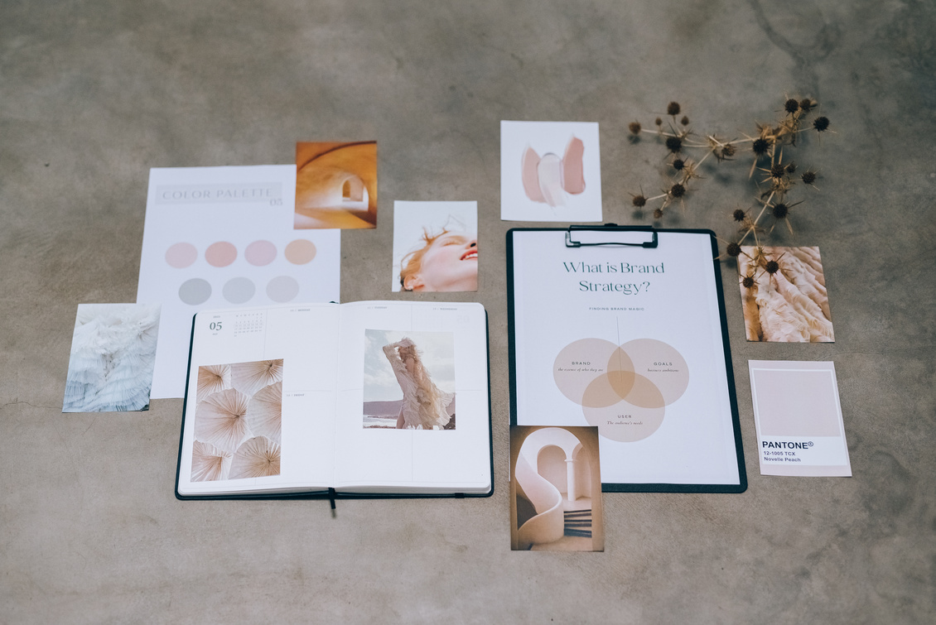
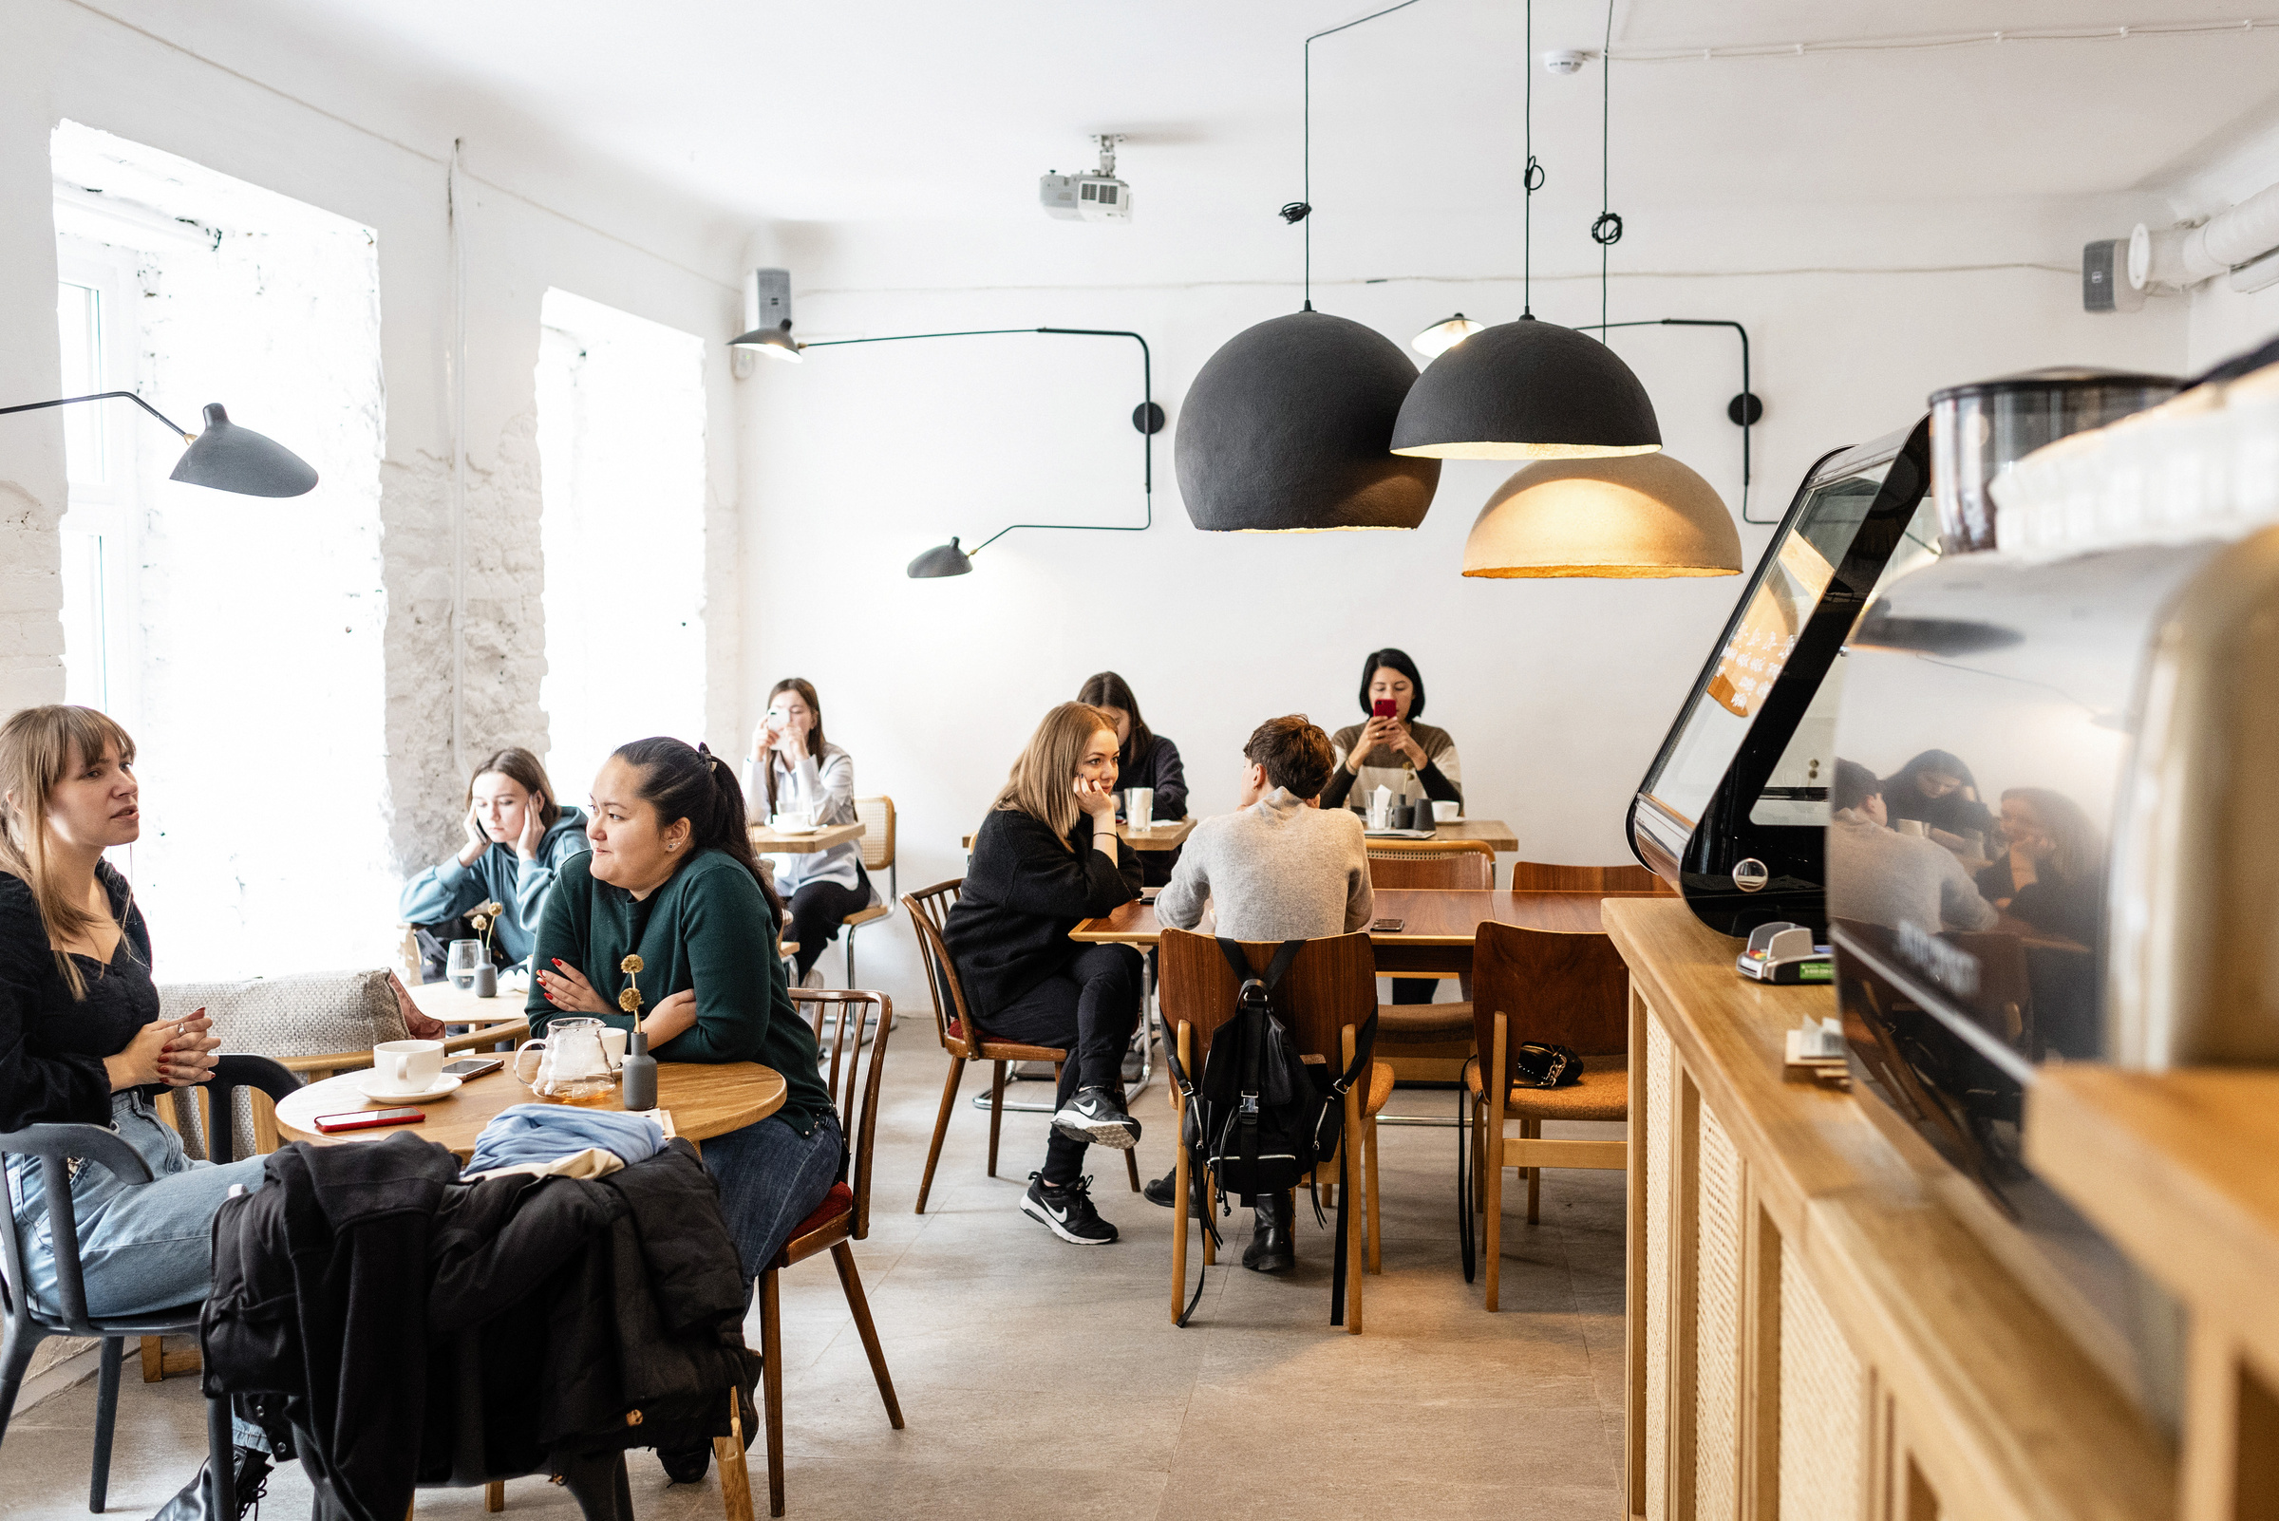

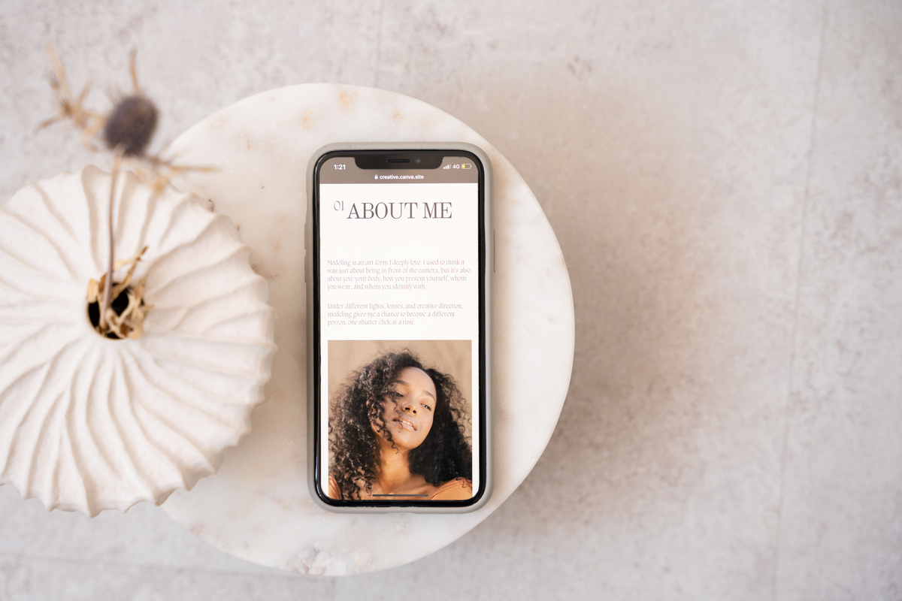
Page 6
Branding Project
Revamp of Fauget Café Brand Identity
Client
Project Duration
: Fauget Café
: March 2022 - June 2022
Overview:
Fauget Café, a local coffee shop, sought to refresh its brand identity to appeal to a younger demographic and better reflect its modern, artisanal offerings. The project included developing a new logo, color palette, typography, and various brand materials.

Slide 3

Page 7
Client Testimonial
Branding Project
We are thrilled with the new look of Fauget Café. The rebranding has not only attracted a new customer base but has also given our loyal patrons a fresh, exciting experience. The design team truly understood our vision and brought it to life beautifully." - Samira Hadid, Owner of Fauget Café

Slide 4

Page 8
Web Design
E-Commerce Website Redesign
Redesigned the e-commerce website for Teddy Yu to enhance user experience, improve navigation, and increase conversion rates. The goal was to modernize the site’s appearance while optimizing it for mobile devices

Slide 5
Page 9
Website Redesign
Client Testimo-
nial
Working with our e-commerce website redesign has been a transformative experience. From the initial consultation to the final launch, demonstrated exceptional creativity, technical expertise, and a deep understanding of our brand’s needs. The new design not only looks stunning but also significantly enhances our user experience.

Slide 6

Page 10
THANK YOU
Let’s Work Together
+123-456-7890
hello@reallygreatsite.com
123 Anywhere St., Any City
@reallygreatsite

